Slide 1
A simple Filter & Recommender System on Movie
2107.11.30

Slide 2
Abstract
Content-based (基于内容) Filtering Recommendation
Extract meaningful features
Similarity Measurement
Collaborative (协同) Filtering Recommendation
Behavior Collection & analysis
User-Based & Item-Based
Hybrid Recommendation …

Slide 3
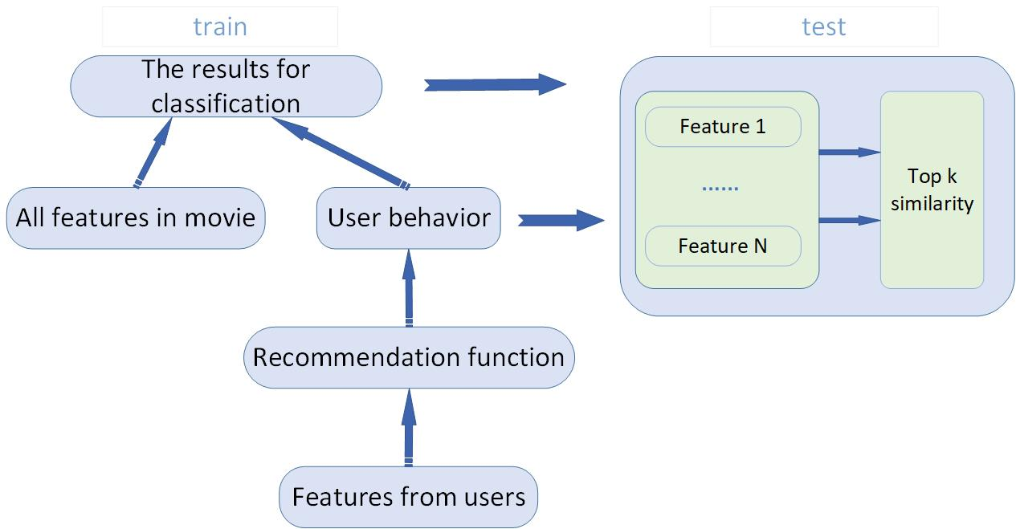
Structure

Slide 4
Feature
Users
ID，Sex，Age，Hobby …
Movies
ID，Name，Style，Label …

Slide 5
Part of work
高慧慧，黄珍：调用API，后台数据收集、预处理，搭建应用框架…
王鹏潇，叶家豪：算法设计，模型训练，调参，后台对接…
前端 emmmm… 进度快的话大家一起来 ☺

